Slide 1
INF10025
Data Management and Analytics
Week 5 – Part 2
Entity Relationship Modelling and Diagrams
SQL

Slide 2
ERD to Relation Model Conversion
What next?
  Soon, we will begin to translate the ERD into a Relational Schema
  E.g. This:
will be translated to: LECTURER (LectId, LecName, Age)
Primary Key (LecId)
or simply: LECTURER (LectId, LecName, Age)

Slide 3
Relational Data Model (RDM)
  Developed by E. F. Codd in 1970.
    Data represented in the form of 2 dimensional tables.
  Each two-dimensional table is called a relation.
    A relation has the following properties:
        A set of uniquely named columns called Attributes.
        A list of unnamed/unnumbered rows called Rows (or Tuples)
        The order of the rows is irrelevant.
        If rows are shuffled, the relation still has the same meaning.
    A Row consists of a sequence of cells
      One cell for each Attribute
      Only one value per cell is allowed.

Slide 4
Conversion to Relational Schema
During conversion from an ERD to a Relational Model:
The name of each entity becomes the name of the relation
The name of each attribute becomes an attribute name
in the relation
Underline the Primary Key value
LECTURER (LecId, LecName, Age)
  The above is called a Relational Schema
  The Lecturer Entity becomes a Lecturer Relation
    The name of the relation is normally written in uppercase.
    The names of attributes are normally written in lowercase or capitalized lower case.

Slide 5
Nulls
A Null is a special value that may be assigned to an attribute when
a value is unknown or inapplicable.
A Null is not a 'space'. It is not a zero. It has a value of NULL.
    Q. Is Karen younger than John?
    A. Unknown. We do not know. It is neither True nor False.
Be careful with results from queries where NULLS may be found.
  Task: Select all lecturers older than Lecturer 207
  Would Karen Fry appear in that list?
LecID | LecName | Age
207 | John Smith | 37
771 | Karen Fry

Slide 6
Converting two entities to Relational Schema
The relational schema for this ERD model would be written as:
LECTURER (LecId, LecName, Age)
Primary Key (LecId)
SUBJECT(SubjectCode, Title, CreditPoints)
Primary Key (SubjectCode)
or
LECTURER (LecId, LecName, Age)
SUBJECT(SubjectCode, Title, CreditPoints)
      Notice that there is nothing that associates a subject to a lecturer.
      The two entities are currently unrelated.

Slide 7
Converting the M:1 relationship
The final step in the conversion process is converting any M:1 relationships
Every M:1 relationship generates
a single Foreign Key
This means that a relation
will have an additional column(s)*
– a foreign key
* - This would be additional columns if
the key was a composite key.
M:1 relationship

Slide 8
Creating a Foreign Key column
The foreign key column is added to the table at the MANY end of the relationship.
The foreign key column name is
usually spelt the same as
the Primary Key it refers to.
  Note: An attribute named LecId is NOT added to the Subject entity.
  A single attribute name must only appear once in an entire ERD
SUBJECT(SubjectCode, Title, CreditPoints, LecId)

Slide 9
The new column is a Foreign Key
The foreign key column is added to the table at the MANY end of the relationship.
The foreign key column name is usually spelt the same as the Primary Key it refers to.
SUBJECT
SubjectCode | Title | CreditPoints | LecId
INF10005 | Intro to Web | 12.5 | 207
INF10017 | EBIS | 12.5 | 345
HPA30088 | Honours Project | 50 | 207
MMD20006 | Media Thesis A | 25 | 119

Slide 10
Converting two entities in the RM
The relational schema for our model is finally written as this:
LECTURER (LecId, LecName, Age)
SUBJECT(SubjectCode, Title, CreditPoints, LecId)
Foreign Key (LecId) References LECTURER
LECTURER
LecID | LecName | Age
207 | John Smith | 37
119 | Jane Pitt | 26
345 | Carol Kent | 34
SUBJECT
SubjectCode | Title | CreditPoints | LecId
INF10005 | Intro to Web | 12.5 | 207
INF10017 | EBIS | 12.5 | 345
HPA30088 | Honours Project | 50 | 207
MMD20006 | Media Thesis A | 25 | 119

Slide 11
ERD to Relational Schema
After this ERD is converted to a relational schema…
    How many columns will exist in table Dept?
    How many columns will exist in table Worker?

Slide 12
Relation vs Relationship
A confusing part of this process is the terminology having similarly sounding terms
LECTURER (LecId, LecName, Age)
SUBJECT(SubjectCode, Title, CreditPoints, LecId)
This line shows a Relationship
Lecturer and Subject are both known as a Relation

Slide 13
Terminology
Every system has it's own terminology!:
Relational Model terminology | MS Access RDBMS terminology | Oracle RDBMS terminology
Relation | Table | Table
Attribute | Field | Column
Tuple or Row | Record | Row

Slide 14
Relational Schema to RDBMS table
Previously we created a Relational schema
LECTURER (LecId, LecName, Age)
SUBJECT(SubjectCode, Title, CreditPoints, LecId)
Foreign Key (Lecid) References LECTURER
We will now create tables for this schema using SQL

Slide 15
Using Oracle & iSQLJunioR
For a few weeks we will be using an Oracle Database.
Actually, you won't really experience much of Oracle
You will interface with Oracle using iSQL JR
    This is Swinburne's Web interface to Oracle
    Can be used anywhere, anytime
    No software is required to be installed on your computer
URL: https://feenix-isqljr.swin.edu.au/

Slide 16
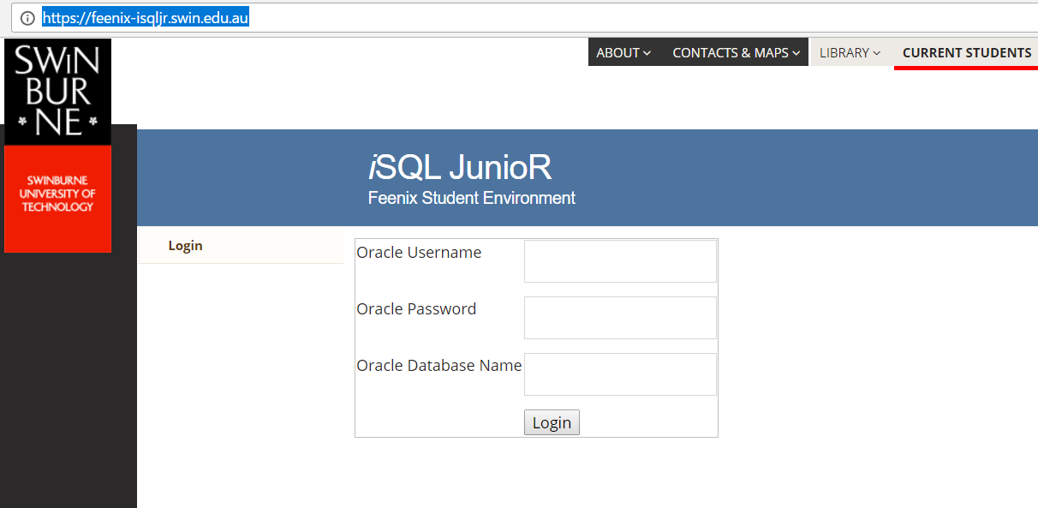
Using Oracle & iSQLJunioR
iSQL JR is used via a web browser
All data is stored on a Swinburne server.
No data is stored on your local computer.

Slide 17
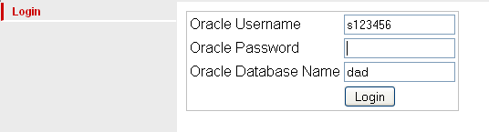
SQL: Using Oracle iSQLJunioR
How to login via ISQL Jr
Password is
Date of Birth in ddmmyy format
251299
s prefix plus your student ID
eg. s123456789
Database Name is:
DAD

Slide 18
SQL: Table storage and access
Your Oracle account:
    It is private (not shared)
    It is where your tables are stored
    Once a table is created and loaded with data it is permanent
        Until the end of the semester
        Or until you drop the table
  Tables are restricted in number and capacity

Slide 19
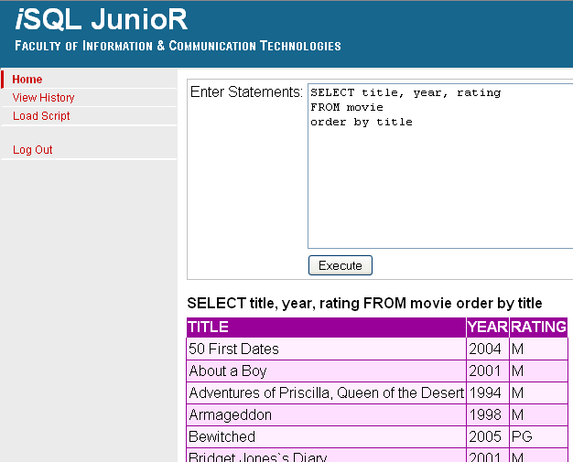
Executing statements in iSQL Jr
Requirement: List rows in the movie table
Type the SQL query into
the TextBox
Click Execute
The results appear
beneath in the
Result Set

Slide 20
SQL: Executing the Movie Table script
Lab 1
Download a file CreateMovie01.TXT from Canvas
Open the file using NotePad (or NotePad++ or any other text editor)
Choose SELECT ALL & Copy in Notepad
CREATE TABLE MOVIE (
MOVIENO NUMBER(6, 0) PRIMARY KEY
, TITLE VARCHAR(100)
, RELYEAR NUMBER(4)
, RUNTIME NUMBER(4)
, RATINGCODE VARCHAR(2)
, COLOUR_CODE VARCHAR(1)
, TMDB_SCORE NUMBER(3,1)
, TMDB_VOTES NUMBER
, TMDB_ID VARCHAR(12)
);
INSERT INTO MOVIE (MOVIENO, TITLE, RELYEAR, RUNTIME, RATINGCODE, COLOUR_CODE, TMDB_SCORE, TMDB_VOTES, TMDB_ID) VALUES(620, 'Ghostbusters', 1984, 107, 'PG', 'C',
6.8, 570, 'tt0087332' );
INSERT INTO MOVIE (MOVIENO, TITLE, RELYEAR, RUNTIME, RATINGCODE, COLOUR_CODE, TMDB_SCORE, TMDB_VOTES, TMDB_ID) VALUES (324668,'Jason Bourne', 2016, 123, 'M', 'C',
7.2, 121, 'tt4196776' );
Varchar() is used for text data
varchar requires a maximum length value
Number() is used for numeric data
Number has an optional max length and decimal places

Slide 21
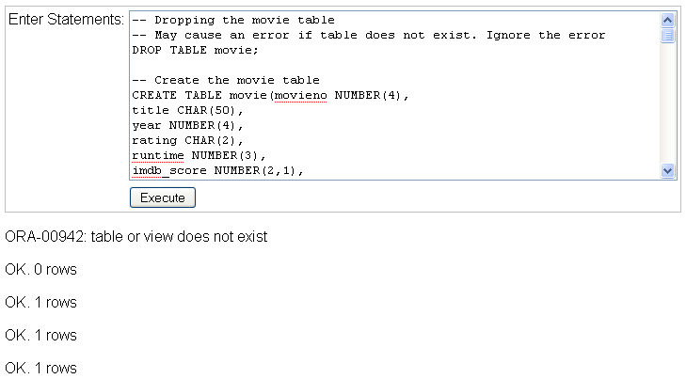
SQL: Creating the Movie Table
In iSQL Jr, Paste the statements into the textbox & click Execute
If you try to create a table that already exists, Oracle will show an Error.
Hence the Drop Table statement at the top of the script.
However, if you try to drop a table that
does not exist, Oracle also shows
an Error.
CREATE TABLE MOVIE (
MOVIENO NUMBER(6, 0) PRIMARY KEY
, TITLE VARCHAR(100)
, RELYEAR NUMBER(4)
, RUNTIME NUMBER(4)
, RATINGCODE VARCHAR(2)
, COLOUR_CODE VARCHAR(1)
Ignore this error message when executing this script.
It is generated by the Drop Table statement

Slide 22
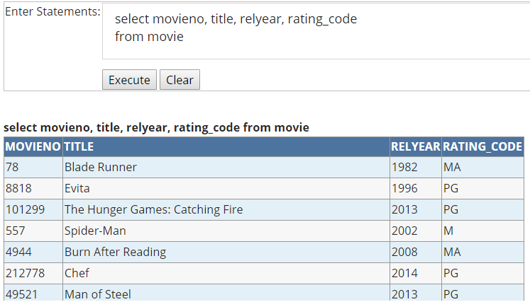
Selecting rows from the Movie Table
List rows in the movie table by typing an SQL query into the TextBox
Click Execute
The results appear
beneath in the
Result Set

